Slide 1

Intermediate R
By Nadia Muhe
Map & Data Library
University of Toronto
unsplash.com/@socialcut

Slide 2
Agenda
DPLYR
If Statements
For Loops
Functions
Resources
github.com/MDLutoronto/r-intermediate

Slide 3
IF STATEMENTS

Slide 4
if(condition) {
statement
}

Slide 5
if(condition) {
statement
}

Slide 6
if(condition) {
statement
} else {
statement
}

Slide 7
if(condition 1) {
statement 1
} else if(condition 2) {
statement 2
} else {
statement 3
}

Slide 8
if(condition 1) {
statement 1
} else if(condition 2) {
statement 2
} else {
statement 3
}

Slide 9
if(condition 1) {
statement 1
} else if(condition 2) {
statement 2
} else {
statement 3
}

Slide 10
if(condition 1) {
statement 1
} else if(condition 2) {
statement 2
} else {
statement 3
}

Slide 11
if(condition 1) {
statement 1
} else if(condition 2) {
statement 2
} else {
statement 3
}

Slide 12
FOR LOOPS

Slide 13
Loops:
for loops
while loops
repeat loops

Slide 14
for (value in sequence) {
statement
}

Slide 15
for (value in sequence) {
statement
}

Slide 16
FUNCTIONS

Slide 17
functionname <-function() {
statement
}

Slide 18
functionname <-function(arg) {
statement
}

Slide 19
functionname <-function(arg1, arg2) {
statement
}

Slide 20
functionname <-function(arg1=value, arg2) {
statement
}

Slide 21
functionname <-function(arg1=value, arg2) {
statement
}

Slide 22
functionname()

Slide 23
functionname(value1, value2)
functionname(value2)

Slide 24

Resources
Intermediate R Quercus course: https://q.utoronto.ca/courses/233262/assignments/syllabus
Cheat sheets: https://opensource.posit.co/resources/cheatsheets/
Carpentries: https://carpentries.org/
R bloggers: https://www.r-bloggers.com/
Online R books: https://bookdown.org/
MDL workshops: https://libcal.library.utoronto.ca/calendar/mdl
MDL support request form: https://library.utoronto.ca/contact-us/data-maps
PowerPoint photo by https://unsplash.com/@socialcut

Slide 25
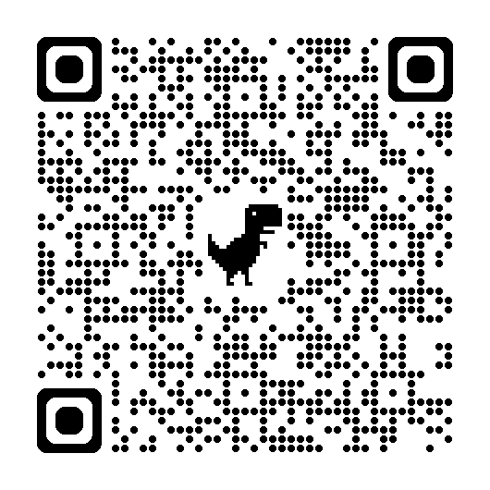
Thank you!
Please scan the QR code or click here to provide feedback.

Slide 26
Contact Information
Nadia Muhe
Statistical Support Specialist
Email: nadia.muhe@utoronto.ca
Phone: 416-978-7689

